Slide 1
status.js @ 2022.08
front.jit #2 (02.08.2022)

Slide 2

Today’s agenda
Stay up-to-date
Hottest topics
Upcoming events
Motivation?

Slide 3
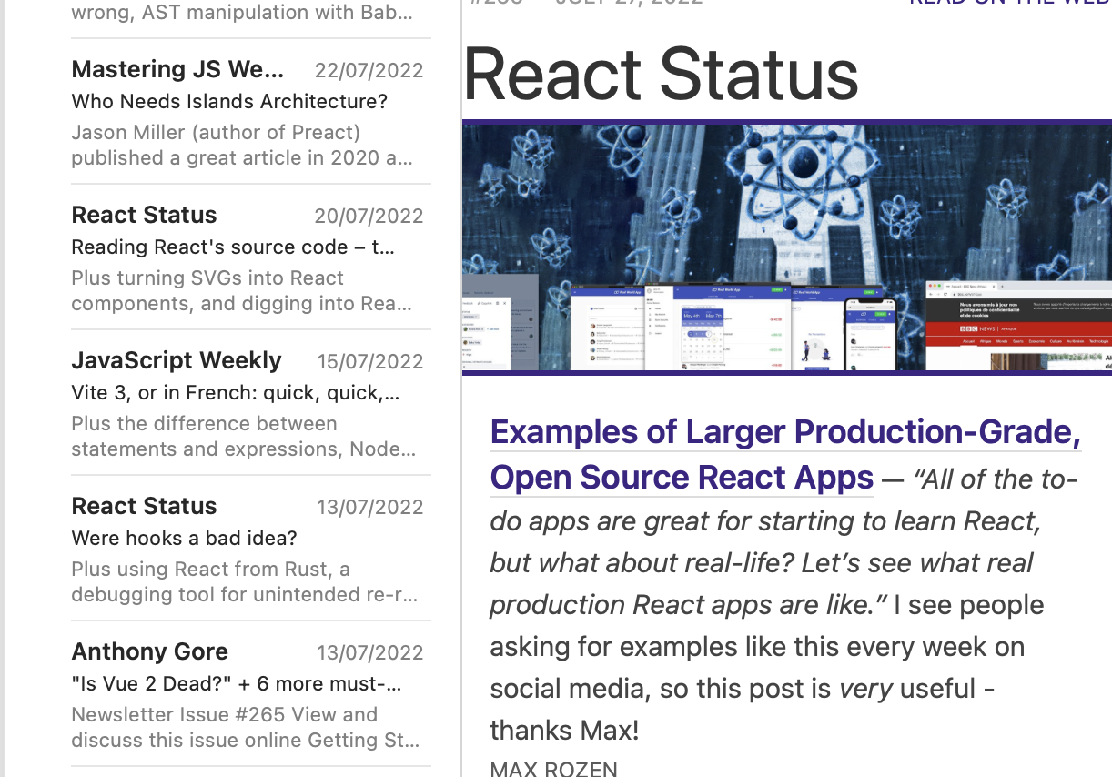
blogs, podcasts, newsletters, tweets…

Slide 4

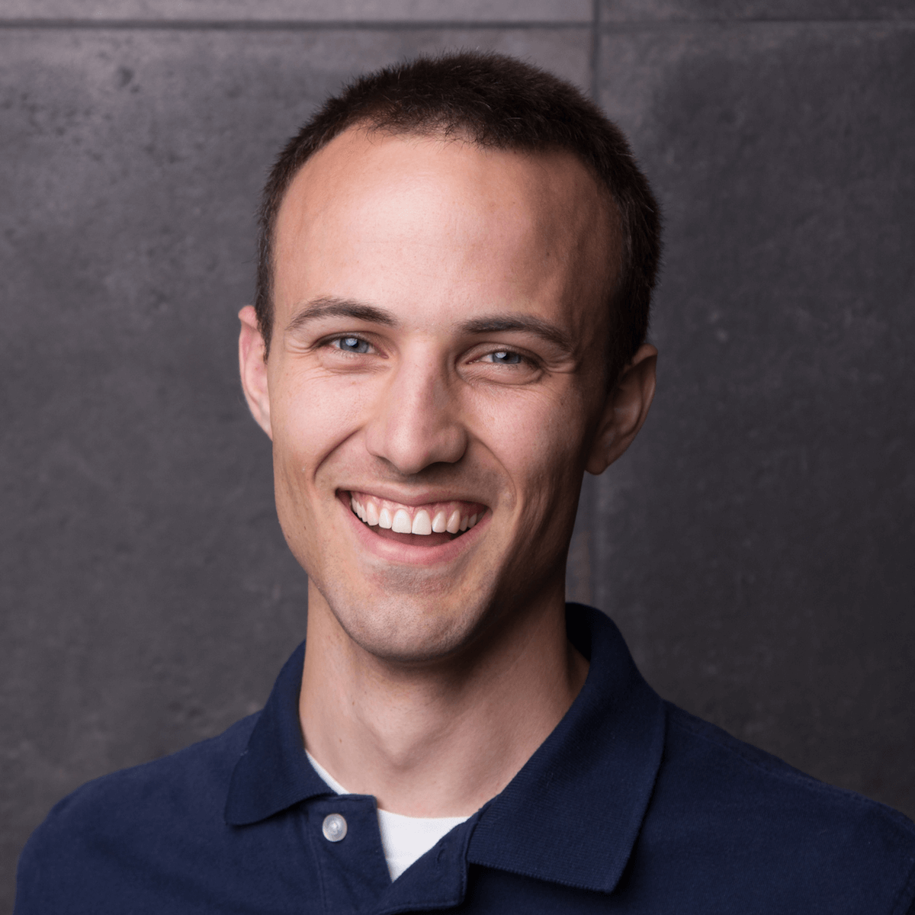
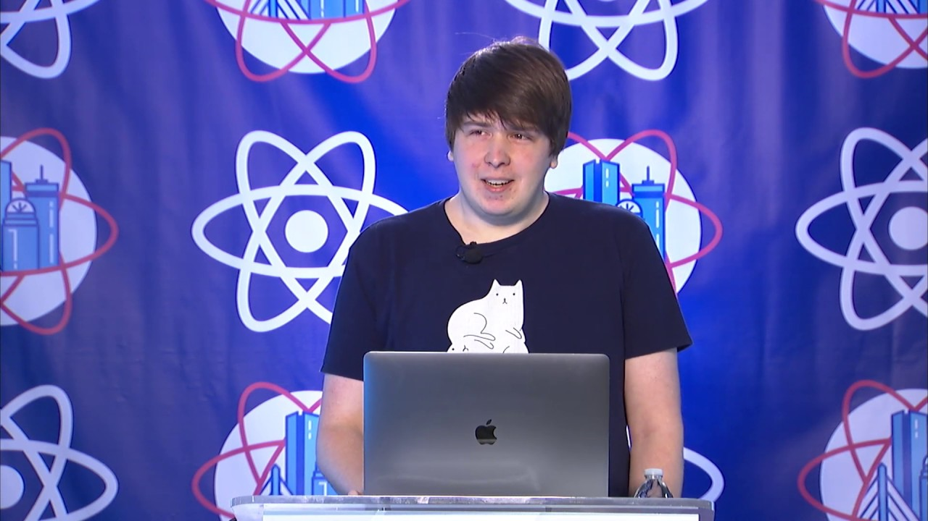
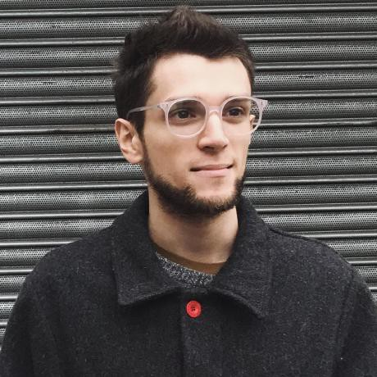
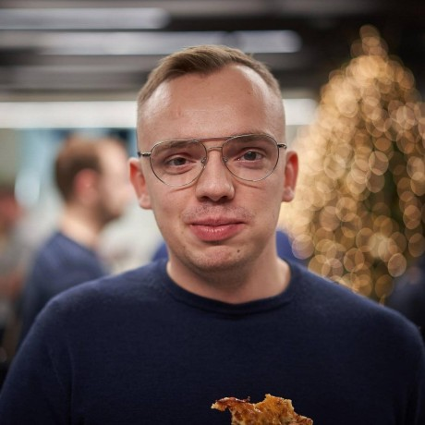
Blogs & podcasts 📼
Śniadanie z programowaniem
Type of Web
polskifrontend.pl
Dan Abramov overreacted.io @dan_abramov
Kent C. Dodds kentcdodds.com @kentdodds
Matt Pocock @mattpocock
Josh W. Comeau @JoshWComeau

Slide 5

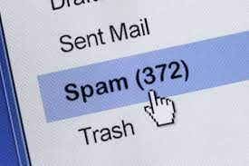



Newsletters 🗞
JavaScript Weekly (javascriptweekly.com)
React Status (react.statuscode.com)
Mastering JS Weekly (getrevue.co/profile/masteringjs)
Vue Developers (@anthonygore, vuejsdevelopers.com)

Slide 6

The coolest things that have met the Frontend, recently

Slide 7





News 🗞
React 18 (29.03.2022)
Angular 14 (02.06.2022)
Internet Explorer – end of live (15.06.2022)
Developer Servey 2022 (22.06.2022)
Digital Service Package (…5.07.2022…)
Bun / Deno

Slide 8
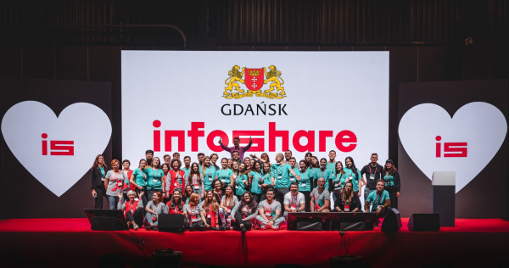
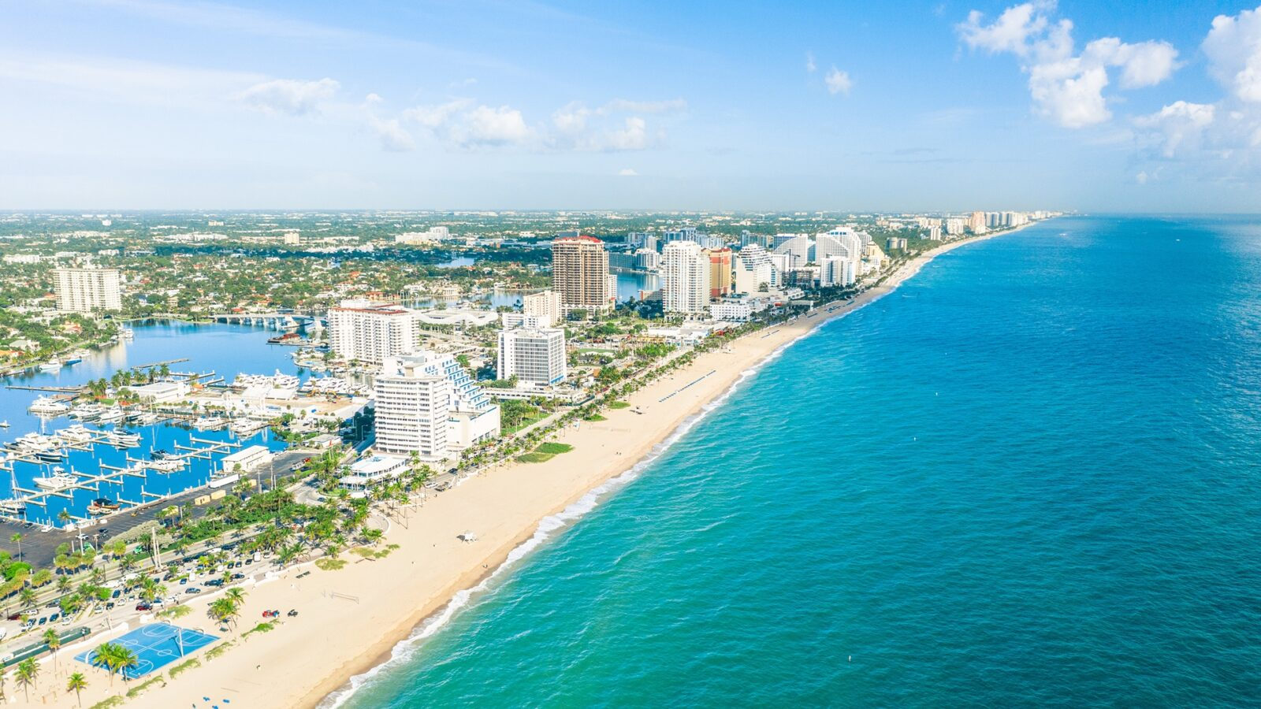
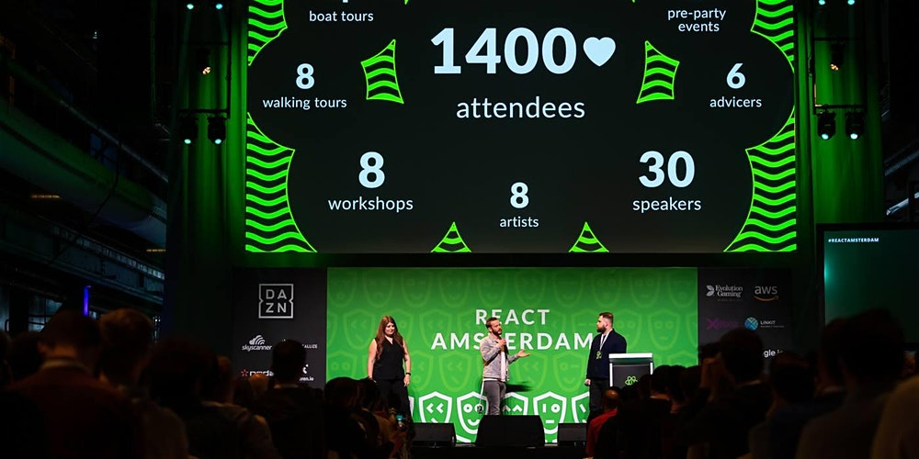


Leave the basement
and let’s get socialized…

Slide 9
2022 Events 🎭
Upcoming
InfoShare (Gdańsk, 6-7.10.2022) 🇵🇱
Dev.js (Online, 13.10.2022) 🇵🇱
Past
React Summit (Amsterdam, 17-21.06.2022) 🇳🇱
VueConf (Fort Lauderdale, FL, 8-10.06.2022) 🇺🇸
reactjs.org/community/conferences.html
events.vuejs.org/conferences
angular.io/events

Slide 10
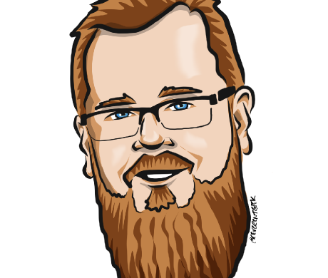
Kyle Simpson
YDKJS (”Tajniki języka JavaScript”)
Github resources @getify
Frontend Masters

Slide 11
status.js @ 2022.08
front.jit #2 (02.08.2022)

